Slide 1

Computer Engineering Department
A.P. Shah Institute of Technology
G.B.Road,Kasarvadavli, Thane(W), Mumbai-400615
UNIVERSITY OF MUMBAI
Academic Year 2020-2021

Slide 2
A Project Report on
Hardware Monitoring Suite
Submitted in partial fulfillment of the degree of
Bachelor of Engineering(Sem-7)
in
Computer Engineering
By
Saumil Padwal (18102012) Vaibhav Shukla (18102069) Mayur Pawar(18102050)
Vikas Prajapati (18102018)
Under the Guidance of
Prof. Pravin Adivarekar

Slide 3
1.Project Conception and Initiation

Slide 4
1.1 Abstract
Hardware Monitoring Suite is a system monitoring app which will be used for tracking of hardware components such as CPU (temperatures, voltages), fan speeds, Core temperature, system hardware detection, PSU load, among others. In addition, it will also provide suggestion of better components than the current components, as well as news about latest hardware for upgrades.

Slide 5
1.2 Objectives
Main Objectives of Hardware Monitoring Suite are:
To retrieve values of fan speeds which helps understand the RPM of fans and also helps identify whether fans are working properly or not.
To detect CPU core temperatures because when a CPU gets too hot, it can cause considerable damage to your device. It’s a good practice to periodically check your CPU temps to ensure you aren’t causing any unnecessary harm on your device.
System Hardware detections which helps in identifying details of CPU, Ram, GPU, etc.

Slide 6
4. To keep tab on voltages. It helps determine the amount of voltage your CPU needs to maintain stability at the default clock speeds.
5. Suggestions for better hardware components than those currently in use.
6. Providing latest and exclusive news related to new upcoming technology.

Slide 7
1.3 Literature Review
Hardware monitoring approaches have successfully been applied in many software engineering tasks, particularly in program profiling, dynamic optimization, and software testing. While advances have been made in improving the efficiency of using instrumentation for program execution monitoring, research has revealed that the use of hardware mechanisms can eliminate or drastically reduce the need for instrumentation. The key trade-off in balancing hardware monitoring and instrumentation use is between the efficiency needed for the approach and the amount and type of observations that must be made. The research presented in this chapter demonstrates how hardware monitoring has been used successfully in balancing these trade-offs in software engineering tasks.

Slide 8
Finally, the efficiency and applicability of hardware monitoring approaches may be improved as the hardware, OS tools, and user level tools continue to develop. Although hardware monitoring research currently focuses on applications executing on commodity machines, their use may potentially aid in testing, debugging, use analysis and application analysis on mobile devices and embedded systems as well.

Slide 9
1.4 Problem Definition
Currently there is a lack of user-friendly and centralized hardware monitoring tools.
The existing tools are quite unintuitive and built for network professionals rather than home users or hobbyists with a single machine.
Tools that take time to fully learn and utilize all features in the platform.
Paid Apps and some of the essential feature are not available in free trials.
User interface can feel crowded and not understandable for laymen.
Open-source versions lack paid support options, and are reliant on community for bug fixes.

Slide 10
1.5 Scope
The main implication of hardware monitoring is to strengthen your grip on the performance of your IT system and lets you measure the exact performance of your system. It not only focuses on the current performance issues but also you can overview of process that might need improvements soon.

Slide 11
1.6 Technology stack
Html / CSS
Tailwind
Node.js
Electron

Slide 12
1.7 Benefits for environment & Society
1. Increase User Satisfaction:
Happier Users attract others, and they usually become a brand-loyal, long-term users of an app. The baseline objective is to have fewer bugs and crashes, so we can provide a platform which makes our users content.
2. Improve End-User Experience:
A fast and responsive software is the basis of UX, and application performance monitoring software can help you identify any related issues.
3. Reduce Downtime:
If 1% of 1 million customers can’t connect, that’s 10K unhappy users, which we can avoid if we proactively monitor app performance and reduce downtime.

Slide 13
4. Speed Up Innovation
Obviously, reducing the time needed to fix bugs, problems frees up more time for your software engineering team to work on adding new features to the app.

Slide 14
2. Project Design

Slide 15
2.1 Proposed System
Core desktop application powered by electron and node.js
Systeminformation library :- It is a System and OS information library for node.js Core modules of the application are :
Hardware information module
Real time monitoring module
Utility Module
OSD (On Screen Display) overlay drawn over windows which shows selected outputs rendered on top of the application that is currently running.

Slide 16
2.2 Design(Flow Of Modules)
Core Module, which is the Hardware information module. It gives the specification of the information system it is running on.
The user can interact with the real time monitoring module which is contained on a separate page for better interaction.
The user can then access the utility module which houses various overlay tools like FPS counters, latency, ping tests, etc.

Slide 17
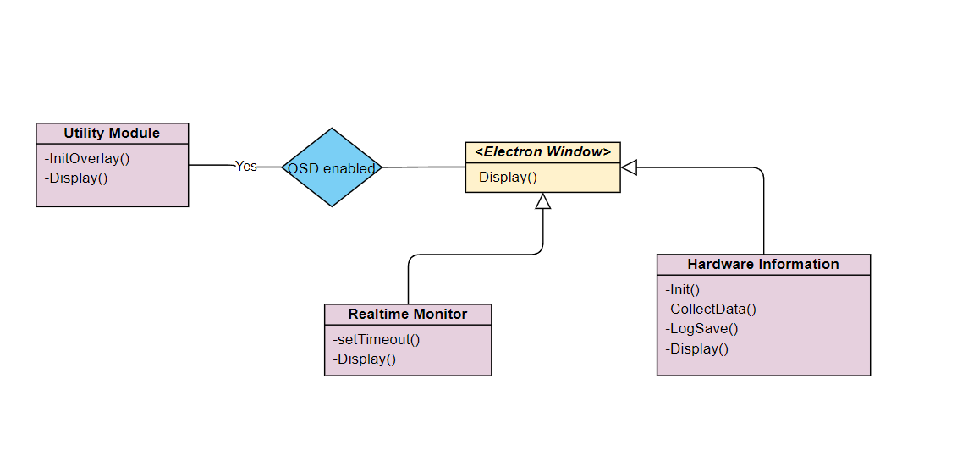
2.3 Class Diagram

Slide 18
2.4 Module-1
Hardware information module:
Displays static information about the system hardware, and temporarily logs to a file.
This information includes make/model of the CPU, GPU, RAM speeds and clock timings, OS information and HDD usage.

Slide 19
Module-2
Real time monitoring module:
Displays real-time info about the system in a dynamic manner.
Uses node libraries that are wrappers of low level C libraries to get real-time information about system CPU temperatures, fan speeds, power voltages, SSD speeds, and VRAM usage, etc.
Output is verbose and cross platform, irrespective of the OS.

Slide 20
Module-3
Utility Module:
This module houses various small tools to improve system monitoring workflow.
This includes, but not limited to: FPS counter, latency and ping test and real-time data like CPU and GPU temps and usage.
All these utilities, shown on your screen through OSD (On-screen display).

Slide 21
2.5 References
Venkata2016(A Real-time Distributed Hardware Health Monitoring Framework)
Computer_Hardware_Mon(Design and Implementation of Computer Hardware Monitoring System Based on Cloud Computing)
Node js(IEE research paper)
Javascript research paper(Modern JavaScript frameworks: A Survey Study)

Slide 22
3.Planning for next semester

Slide 23
Planning
Suggestion for System/Hardware upgradation
Implementing news section
FPS overlay
Improving existing features and UI
Drivers updating system

Slide 24
Thank You

